Slide 1

DATA STRATA
Divyansha divyansha1115@gmail.com
Satashree Roy spamiroy26@gmail.com
Apoorva Singh singhapoorva388@gmail.com

Slide 2
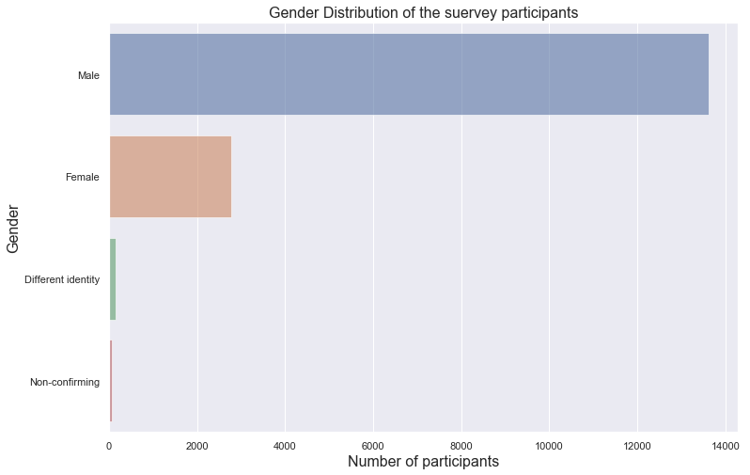
GENDER DISTRIBUTION
A graphical approach to understanding of influence of gender distribution on becoming a data scientist

Slide 3
Useful Insights from the gender data
GENDER | % of participants
Male | 81.88%
Female | 16.71%
A different Identity | 1.41%
Non-conforming | 0%
Valid Response◼ | 16600 | 99%
Unconventional Response◼ | 95 | 1%
Missing Response◼ | 0 | 0%
Most Common | MALE
Using the graphical analysis and the reasoning portrayed as above we can derive the conclusion that males have currently dominated the domain of Data Science.

Slide 4
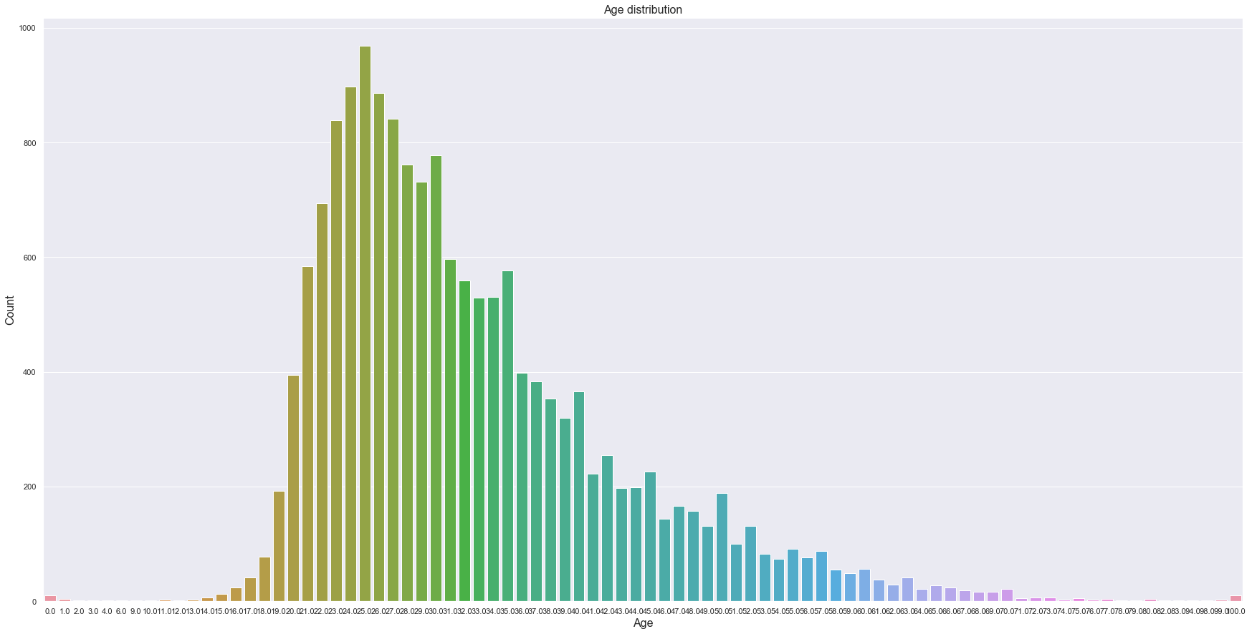
AGE DISTRIBUTION
A graphical approach to understanding of influence of age distribution on becoming a data scientist

Slide 5
Useful Insights from the age data
Age | % of participants
25 | 6%
26 | 5%
27 | 5%
28 | 5%
<25 and >28 | ~ 78%
Valid Response◼ | 16700 | 100%
Unconventional Response◼ | 0 | 0%
Missing Response◼ | 0 | 0%
Most Common | 25
Using the cumulative frequency count from the graph and the percentage share of various age groups, we can derive the inference that most active age group of Data Science community belongs to age group of 21-36 years with people having age of 25 are most active Data Scientists.

Slide 6
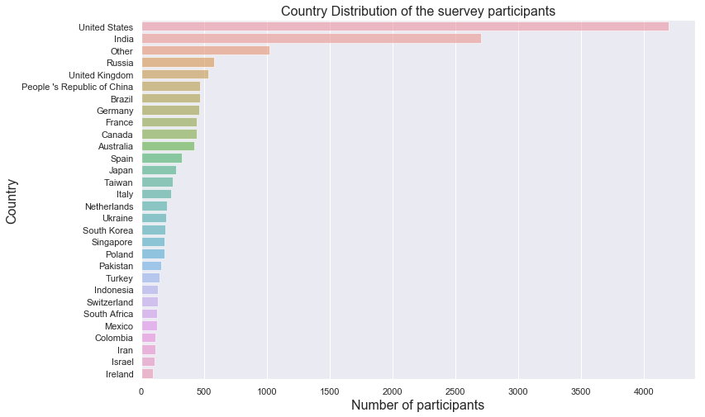
COUNTRY-WISE DISTRIBUTION
A graphical approach to understanding of influence of nationality on becoming a data scientist

Slide 7
Useful Insights from the country data
Country | % of participants
United States | 25%
India | 16%
Russia | 3%
Not specified | 6%
Other Countries | 49%
Valid Response◼ | 16600 | 99%
Unconventional Response◼ | 121 | 1%
Missing Response◼ | 0 | 0%
Most Common | United States
The graphs and logistics clearly demonstrate that being from or working in United States or India elevates the odds of one becoming a Data Scientist by manifolds. United States and India contribute to the 41% of the total Data Scientists currently operating worldwide.

Slide 8
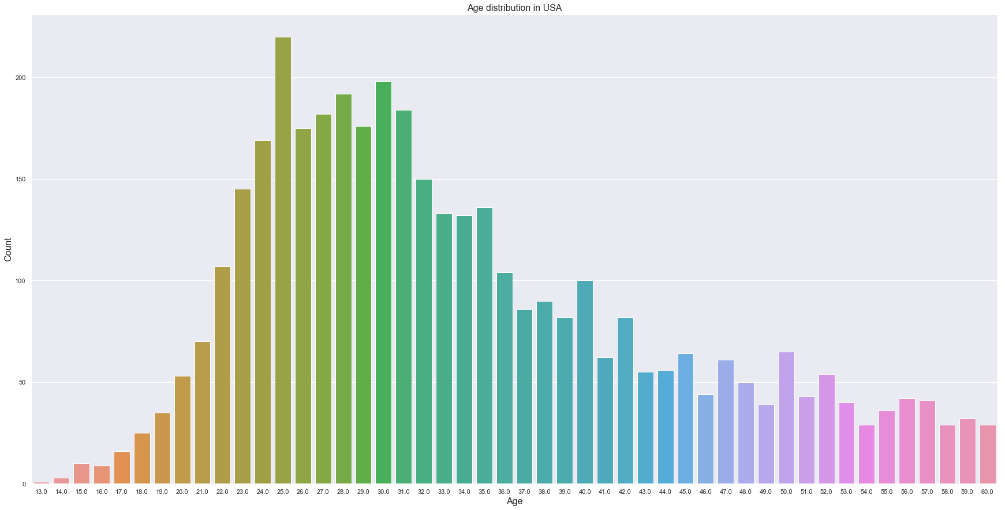
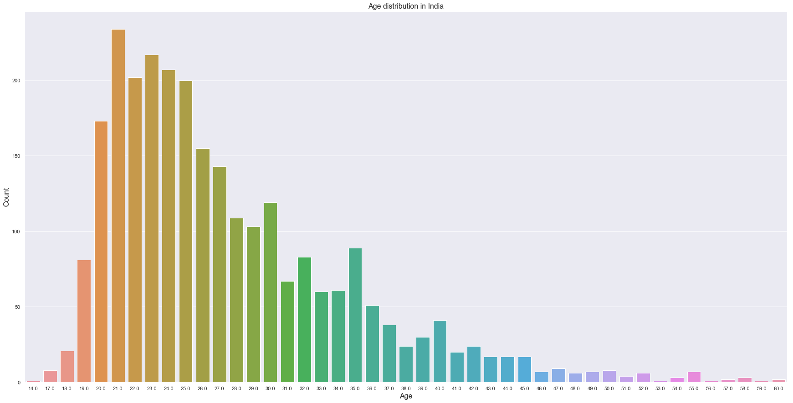
COMPARATIVE STUDY OF AGE GROUPS OF DATA SCIENTISTS OPERATING IN UNITED STATES v/s INDIA
The graphical representation of United States clearly show that Data Scientists in USA are majorly aged between 24-36 while from the bar graph of India shows that Indian Data Scientists belong to age group of 19-27.
This observation leads us to the conclusion that Data Science technological trends are relatively new in India when compared to a country like United States, and that more of Indian youngsters have taken up the field.

Slide 9
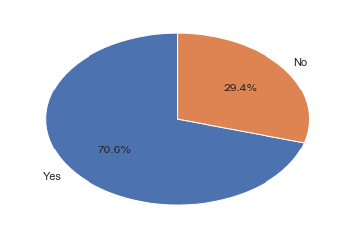
CAREER SWITCH
A graphical approach to understanding of influence of career switching on becoming a data scientist

Slide 10
Useful Insights from the career switch data dat dat data
Career Switcher | % of participants
Yes | 70.6%
No | 29.4%
Valid Response◼ | 3012 | 18%
Unconventional Response◼ | 13700 | 82%
Missing Response◼ | 0 | 0%
Most Common | Yes
The data on career switching gives us an idea that most of the Data Science professionals working in this field did not actually start out their careers as same. About 71% of them worked in some different domains before they became Data Science Enthusiasts. This also supports the hypothesis that the idea of Data Science is relatively new.

Slide 11
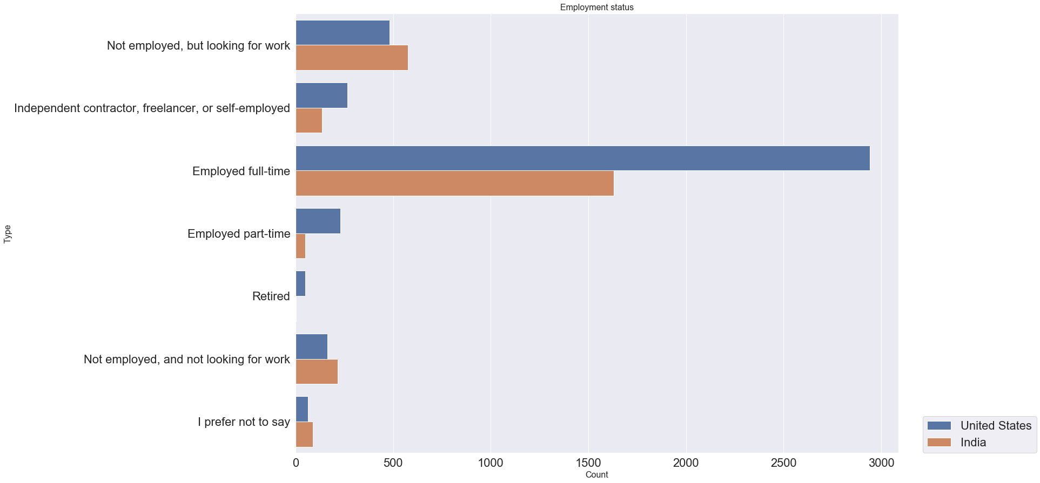
EMPLOYMENT STATUS DISTRIBUTION
Are data scientists employed?

Slide 12
Useful Insights from the employment status data datdata
Employment Status | % of participants
Employed Full-Time | 65%
Not employed, but looking for work | 13%
Independent contractor, freelancer, or self-employed | 8%
Not employed, and not looking for work | 6%
Other | 9%
Valid Response◼ | 16700 | 100%
Unconventional Response◼ | 0 | 0%
Missing Response◼ | 0 | 0%
Most Common | Employed FullTime
The logistics clearly indicate that most of the Data Scientists are professionals who are employed full time and even if not, they are looking for work. This means that the field of Data Science is for people who are dedicated to this particular domain only.

Slide 13
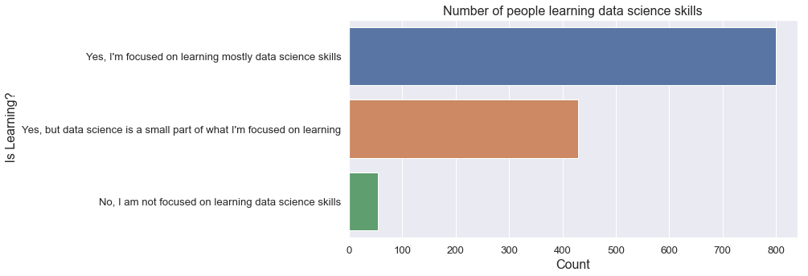
Visualization of the number of people learning data science
We observe that a majority of the sample is completely focused and dedicated to data science.
Around 33.4% of them are practising it in addition to some other work. Around 4.2% of them are not interested in learning data science.

Slide 14
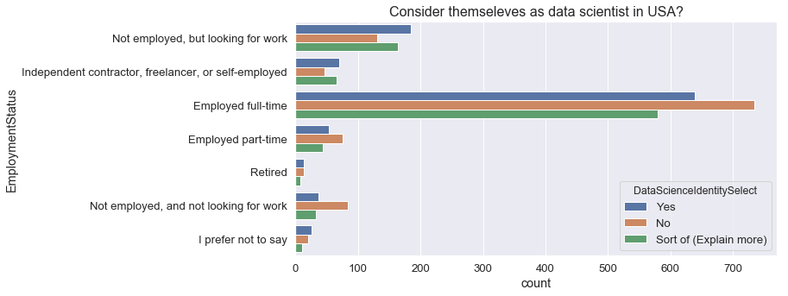
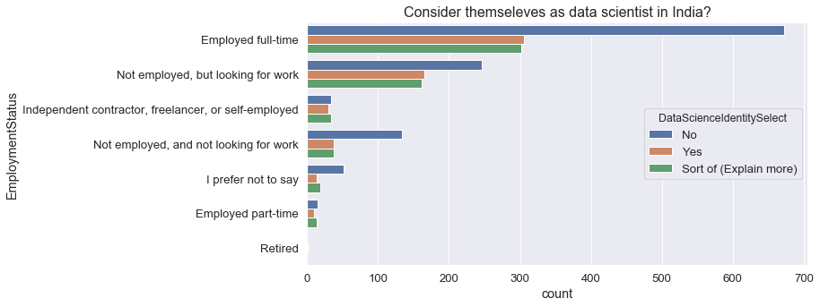
CORRELATION BETWEEN NATIONALITY, DATA SCIENCE IDENTITY AND EMPLOYMENT STATUS

Slide 15
INSIGHTS FROM CORRELATION BETWEEN NATIONALITY, DATA SCIENCE IDENTITY AND EMPLOYMENT STATUS
From the curves, we can infer that most of the people who are employed full time in USA and India do not identify themselves as Data Scientists. Also, this number is much higher in India as compared to States; meaning data science isn’t as prevalent in India.
Also, the number of people currently unemployed and looking for work do not consider Data Science as an alternative in India while this number is lesser for States.

Slide 16
TIME SPENT BY DATA SCIENTISTS
Majority of time spent by Data Scientists are on -
Gathering Data
Finding Insights
Visualizing
Model Building
Production
In the next slide we have tried to visually compare the percentile of time spent by Data Scientists on various activities-

Slide 17
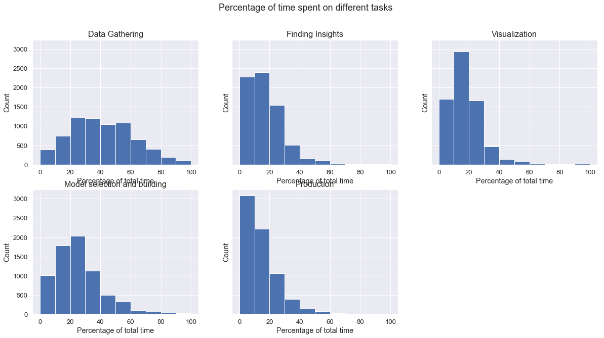

Slide 18
INSIGHTS
Through the graphs it is clear that majority of Data Scientists spend most of the time gathering data. This implies gathering the data and processing it is an integral step in Data Science.
Model Selection and Model building also earns a lot of time from the Data Scientists.
The production generally requires least time among all the processes.

Slide 19
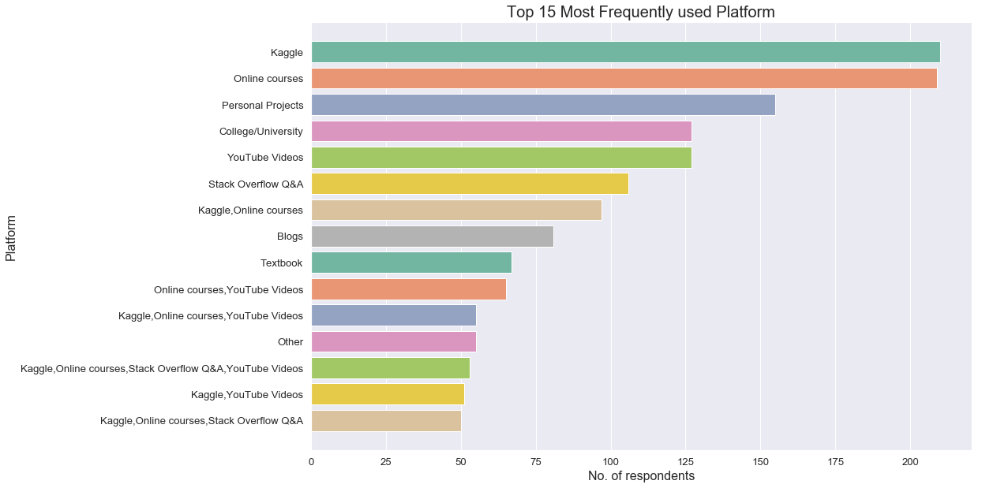
PLATFORM USED
A graphical approach to understanding of influence of platform used on becoming a data scientist

Slide 20
INSIGHTS FROM VISUALIZATION OF PLATFORM USED.
The bar graph clearly shows that the two most popular platforms for learning data science are Kaggle and MOOCs. A vast number of them also take up personal projects to hone their skills. This is followed by university courses, and YouTube with its large collection of videos.

Slide 21
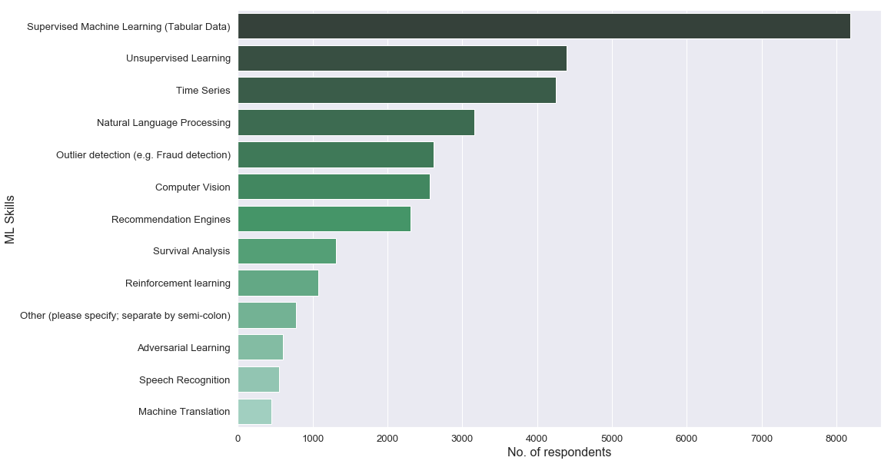
VISUALIZATION OF THE SAMPLE’S MACHINE LEARNING SKILLSET

Slide 22
INSIGHTS FROM THE VISUALIZATION
Supervised Learning seems to be the most popular Machine Learning skill.
Unsupervised Learning and Time Series closely follow but are still quite behind Supervised Learning.
The rest such as Reinforcement Learning, Adversarial Learning, Speech Recognition are not as popular.
We may infer that a successful data scientist would be a master at at-least Supervised Learning.

Slide 23
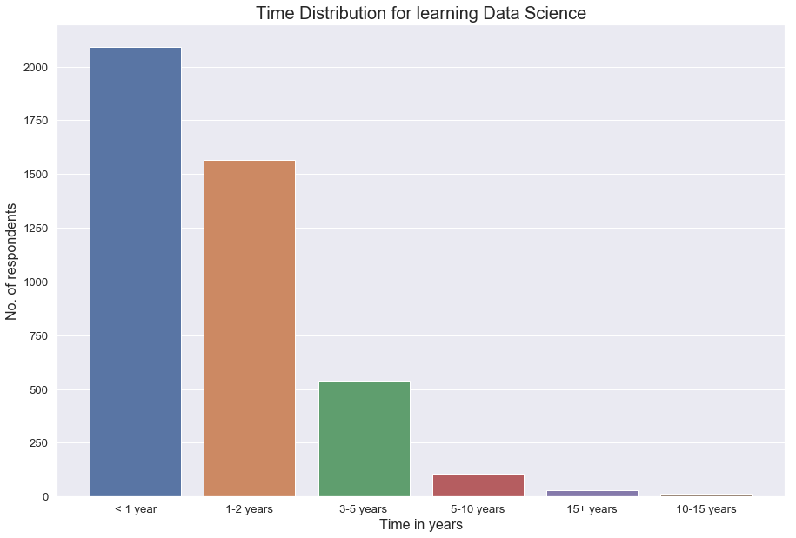
TIME DISTRIBUTION FOR LEARNING DATA SCIENCE
We infer from from this visualization that a good grasp of data science may be attained even in less than a year of practice. A large proportion of people require at most 2 years to become proficient at it. Only a handful of them have spent extremely long periods of time.

Slide 24
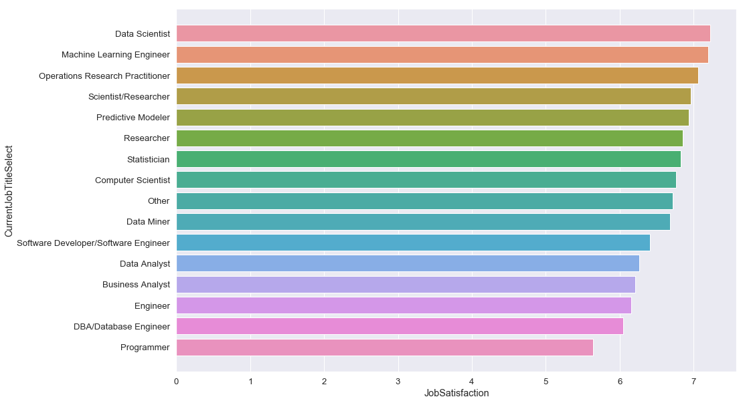
VISUAL REPRESENTATION OF JOB SATISFACTION IN THE DOMAIN
We observe that the job satisfaction quotient in the field of data science and machine learning is very high. Research work and statistics also have high quotients.
All of the job titles mentioned in the graph have satisfactory quotients.

Slide 25
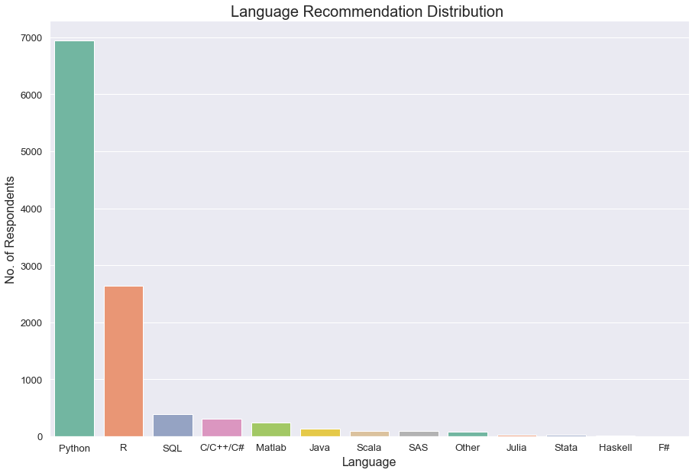
MOST POPULAR LANGUAGES
Out of all the languages mentioned such as Python, R, SQL, C/C++, MATLAB, etc., The most popular two turn out to be Python and R.
Majority of them are familiar with both the tools.
We may infer that a successful data scientist would be skilled in either Python or R or both (though not necessarily).

Slide 26
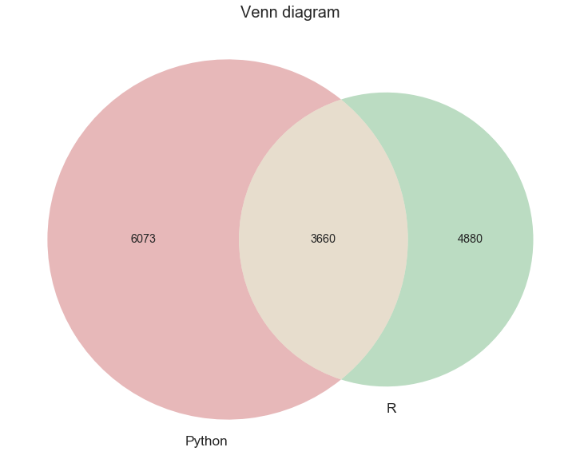
DISTRIBUTION BETWEEN THE TWO MOST POPULAR TOOLS

Slide 27
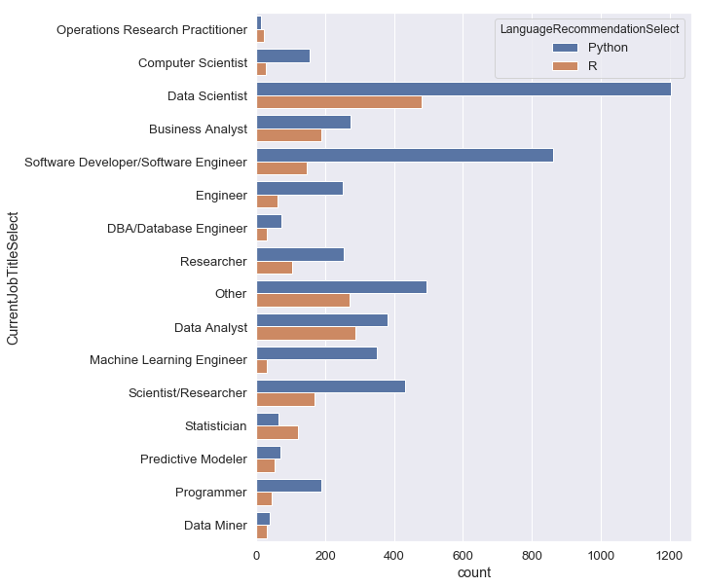
VISUALIZATION OF RECOMMENDED LANGUAGE FOR DIFFERENT SPECIALISTS
We observe that for most job titles the recommended language is Python. Data scientists, analysts and ML practitioners use Python extensively. R seems to be the popular amongst statisticians.
We can infer that in both industry and research, Python is the favoured language.

Slide 28
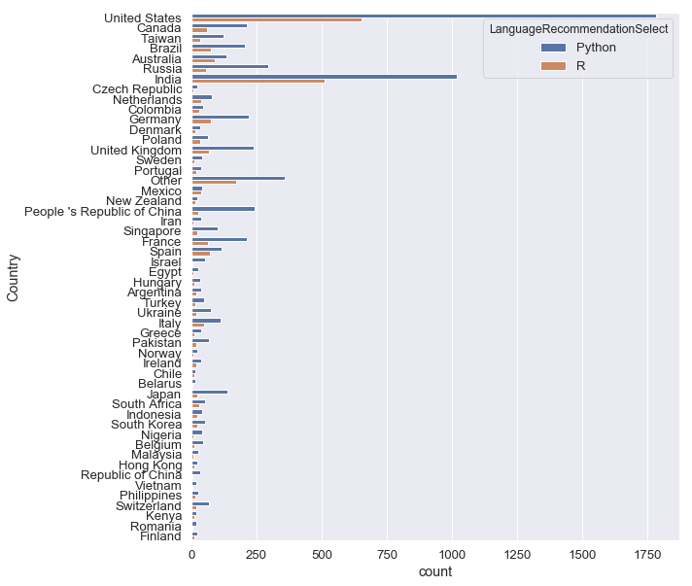
COUNTRY WISE LANGUAGE PREFERENCE

Slide 29
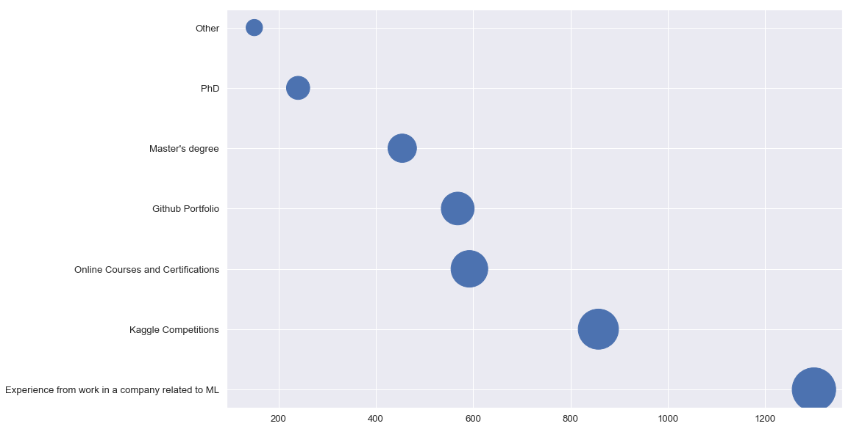
PROOF OF KNOWLEDGE OF SKILLS
To have strong hold of the field, work experience and successful projects as well as taking part in Kaggle competitions seem to be prevalent. Most of the data scientists also earn at least a degree.

Slide 30
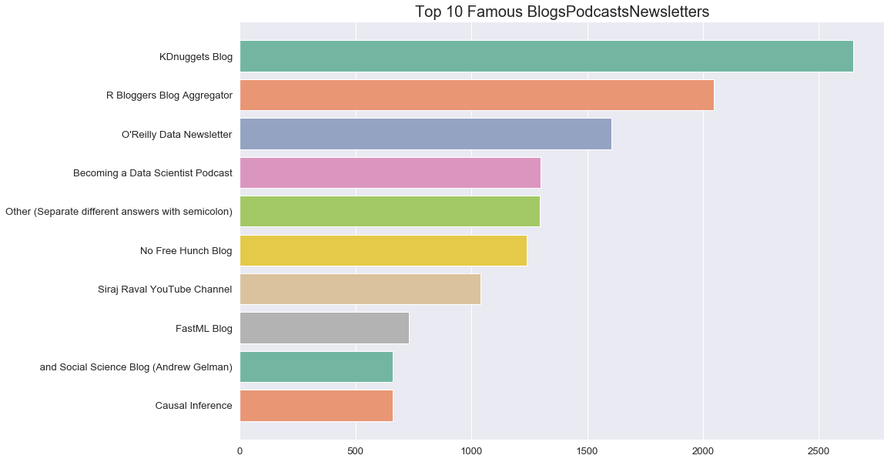
POPULAR BLOGS/PODCASTS/NEWSLETTERS

Slide 31
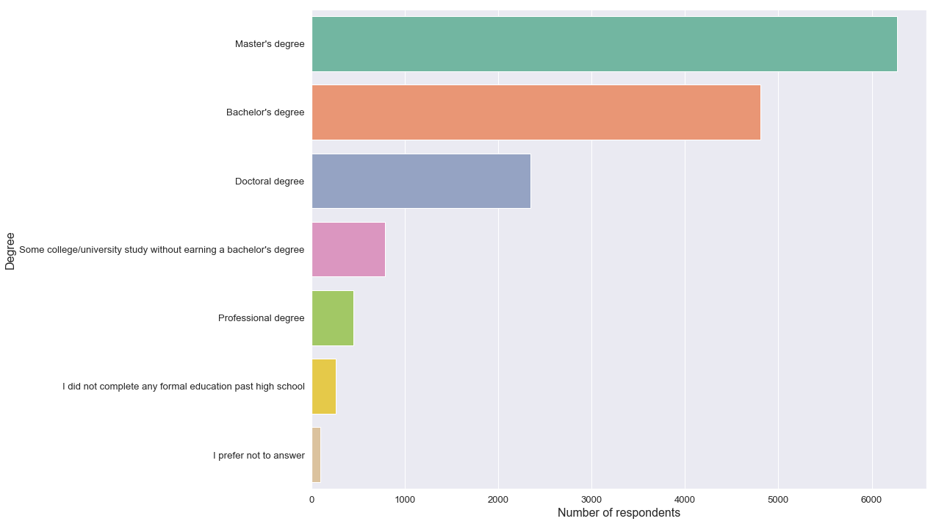
WEIGHTAGE OF DEGREE
A graphical approach to understanding of influence of having a degree on becoming a data scientist

Slide 32
INSIGHTS FROM THE CURVE
Having a degree makes things a lot more easier for the people who work in the domain of Data Science.
67% people have either a Master or Bachelor degree.

Slide 33
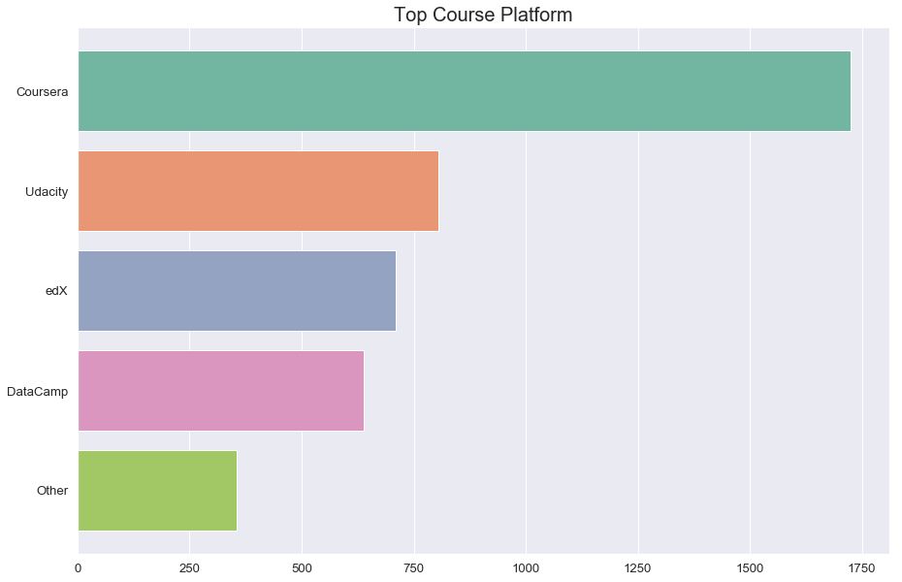
VISUAL REPRESENTATION OF THE TOP ONLINE COURSE PLATFORMS
Amongst the top 4 MOOC platforms, the most popular amongst aspiring data scientists seems to be Coursera.
Udacity, EdX, DataCamp closely compete each other but are quite lagging behind Coursera.

Slide 34
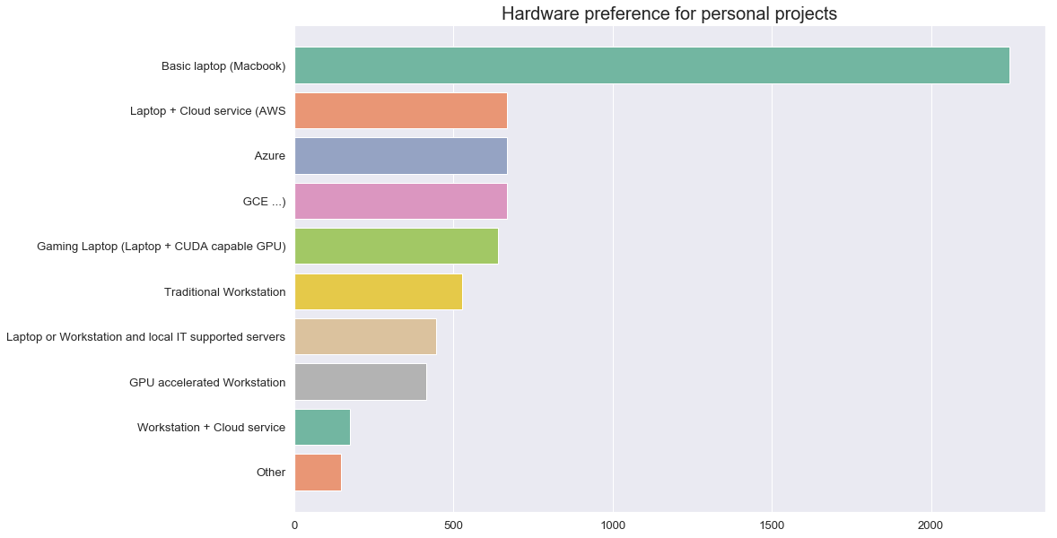
VISUALIZATION OF HARDWARE PREFERENCE FOR DATA SCIENTISTS

Slide 35
INSIGHTS
Having a personal system (laptop) is handy for most data scientists and learners.
A proportion of them also use cloud based services like, Amazon Web Services, and CUDA capable GPU systems.

Slide 36
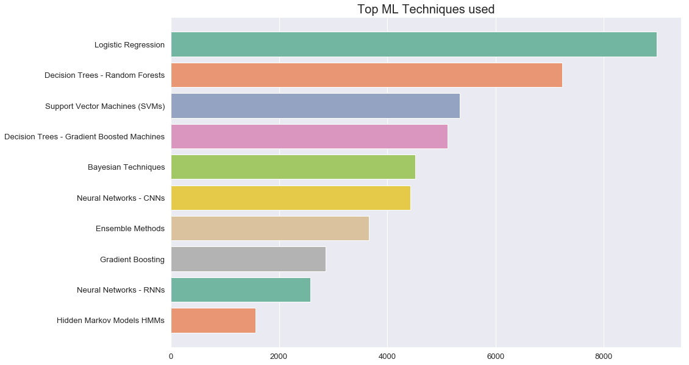
TOP ML TECHNIQUES USED
Logistic Regression is the most commonly used Machine Learning technique, followed by Random Forests.
We infer that these ML techniques should be known by data scientists.

Slide 37
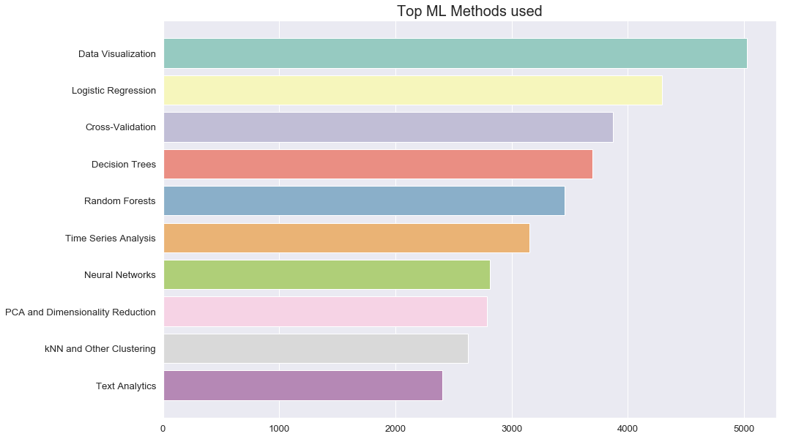
TOP ML METHODS USED
From the graph we can infer that data scientists should be proficient in data-visualizations, followed by certain Machine Learning models like Logistic Regression, Decision Trees, Random Forests.

Slide 38
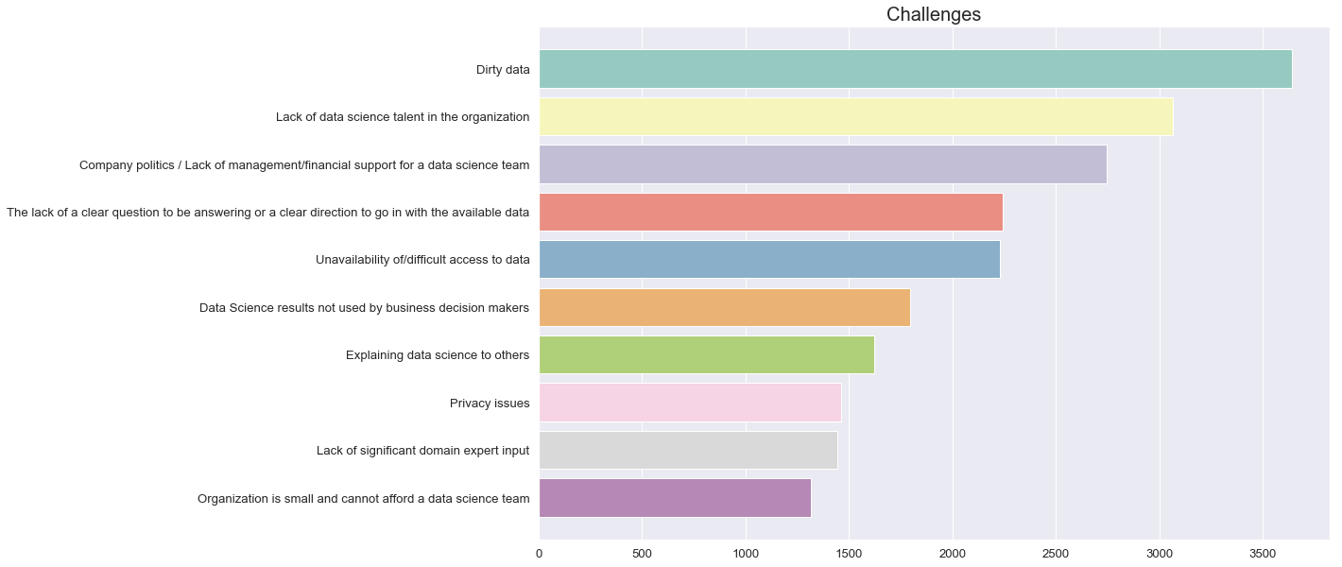
CHALLENGES FACED BY DATA SCIENTISTS

Slide 39
INSIGHTS FROM THE VISUALIZATION
The biggest problem for a data scientist seems to be unclean data, and hence cleaning and processing the data becomes a challenge.
Considering the situation of an organization, the lack of talent and company-politics, also seem to be a challenge.
Unavailability of data and lack of specific direction also slow down a project.

Slide 40
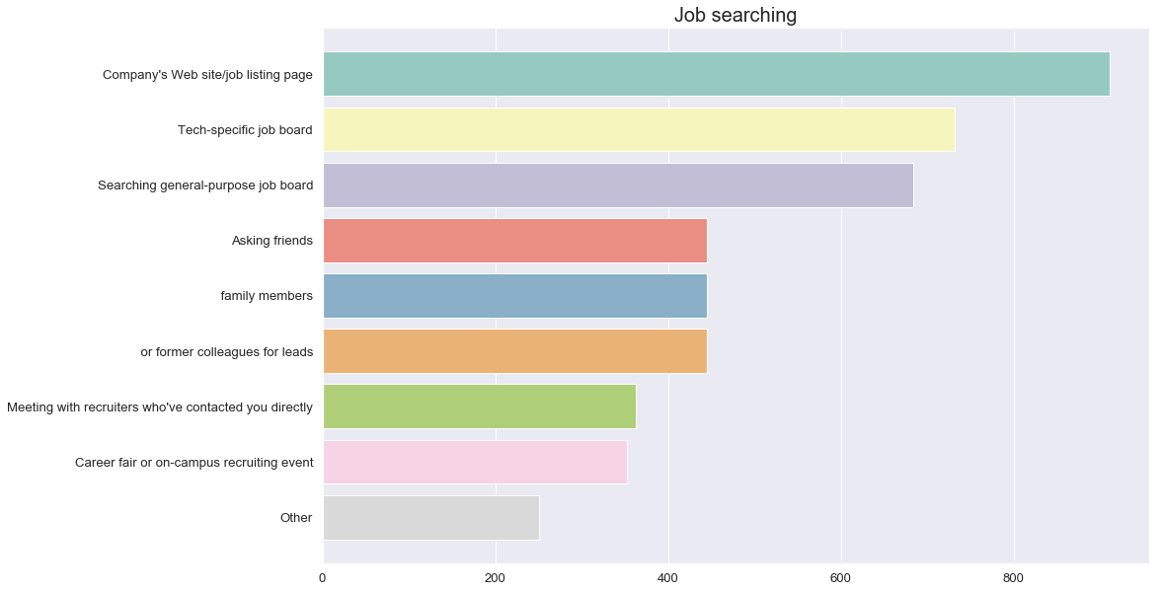
VISUALIZATION OF THE WAYS OF SEARCHING JOBS IN DATA-SCIENCE

Slide 41
INSIGHTS FROM THE VISUALIZATION
The most common way for searching jobs in the field of data science is by going through the job listing-page of various companies.
Contacting a tech-specific or a general job board can also significantly help.
Asking friends, family members or former colleagues for leads, are equally important.

Slide 42
CONCLUSION
GIVEN PROBLEM STATEMENT : What is the best approach to become a Data Scientist ?
RESPONSE:
The given problem is a matter of subjective interest and has no particular correct answer that can address the subject with impeccable precision. We have tried to respond to the problem statement using the insights derived from the data using analysis and the basic background knowledge of Data Science.
The various approaches that helps one’s purpose in becoming a Data Scientists are-
United States and India contribute 41% to the Data Scientists currently active in the community. This means these skills are highly sought after in American and Indian markets and the enthusiasm for research about Data Science is much more higher in these countries.
So, we can infer that studying, researching or working in United States or India can boost one’s career as Data Scientist.

Slide 43
2. 64% of the Data Scientists started their venture using University courses or various online platforms’ courses (Coursera, EdX, Udemy,etc) about Data Science. 25% were self taught.
This means using University Courses or online MOOCs are most thriving ways to kick off one’s journey in this domain. Self-teaching is also proven to be successful at most occasions.
3.
4.
5.
People in age group 22-36 years are most active in Data Science Community. This means anyone having age in this range and below has high chances of ending up as Data Scientist.
Taking up a full time employment has proven to be a more successful approach when compared to working part time or independently.
Focus of the candidate has proven to be a principal factor in determination of one’s ability as Data Scientist. Over 60% of people currently working in domain have their utmost priority as Data Science while about 30% hope to learn Data Science as a part of their work.
So, totally focusing on Data Science works much better than learning Data Science for interdisciplinary assignments.

Slide 44
6.
7.
8.
9.
10.
11.
It has been observed that Data Science professionals invest lots of time in gathering and preprocessing data. As the popular notion about data goes- “Garbage in, Garbage out”.
So, secret of becoming a good data scientist lies in investing more time in gathering data and selecting model than rest of the task.
Kaggle, online courses and personal projects are proven to be most widely used platforms among Data Scientists. So, using Kaggle, online courses and doing personal projects is highly recommended to people who wish to learn Data Science.
58% of Data Scientists use either Python or R for as their mode of problem tackling.So, professional familiarity with Python or R ( Python highly preferred) can give a learner edge in this sphere.
Reading blogs (preferably KDnuggets and R Bloggers Blog Aggregator) can really enhance one’s skill as Data Scientist.
Most of the people of this sphere, it has been found, have earned a Master’s or at least a Bachelor’s degree. So, taking up a degree also boosts one’s odds.
Coursera, Udacity and edX are highly acknowledged online learning platforms for new learners.

Slide 45
12.
39% of people having expertise in this domain have done majors in either Computer Science or Mathematics.
So, taking up Mathematics or Computer science (preferred) for majors supply the necessary prerequisite knowledge for Data Science.
13.
14.
15.
Laptop having basic environment (Macbook) like Linux, etc is popular among Data Scientists to
conduct projects. So, using such hardware is recommended for learners too.
Practise of using Logistic Regression and Decision trees is prevalent among Data Scientists.
So, learning such techniques can prove really useful.
Data Visualization, Logistic Regression and Cross Validation are the Top ML techniques used.
So, an extensive knowledge of these algorithm is a must.

Slide 46
Thank You

